Slide 1
speech
Detail Extractor
Rules Checker
Detail Extractor
ER Image
TXT FILE GENARATOR
Generate ER Diagram
Mapping & Normalization
Generate ER SQL quarries

Slide 2
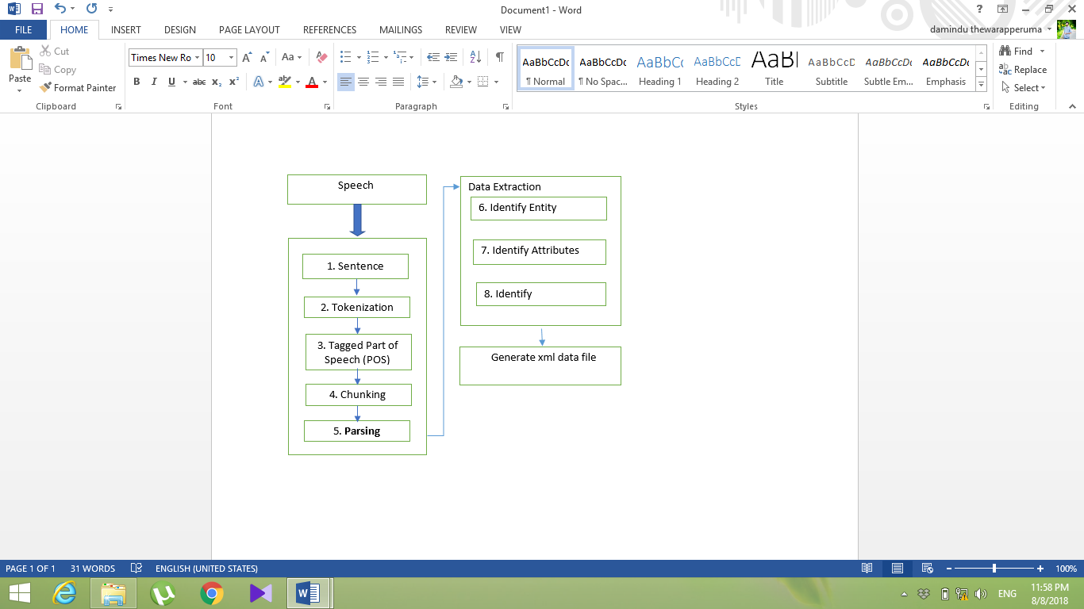

Slide 3
Extracted data
ER to Relational Mapping
Database normalization
Strong Entities
First Normal Form
Binary 1:1 Relationships
Second Normal Form
Third Normal Form
Binary 1: N Relationships
Binary M: N Relationships.
Multivalued Attributes
TXT output
TXT output
Create SQL Query’s
Create SQL Query’s

Slide 4
XML FILE
Generate ER Diagram
Detect correct Relationship Identify Entities, Attributes & Relationship
p among Entities
Detect correct Relationship among Entities
Check Cardinality between Relationship & Entities
Check ER Rule
ER-DIAGRAM

Slide 5
ER Image
Picture of Text
Convert to Gray scaling
Identify Entity
Segmentation
Identify Attribute
Contours & Shapes
Identify Relationships
Identify Words
Identify cardinalities
Feature Extraction
TXT File
TXT File

